Slide 1

IntelliJ + Java JDK Set-up Guide

Slide 2
Contents
Background
Downloading
Installing
Creating a Project

Slide 3
Background
IntelliJ is an open-source, cross-platform, industrial-level IDE with several features that make it superior to entry level IDEs.

Slide 4
Download IntelliJ IDEA
In order to install IntelliJ, you’ll need to download a set-up file from jetbrains.com:
Download IntelliJ

Slide 5
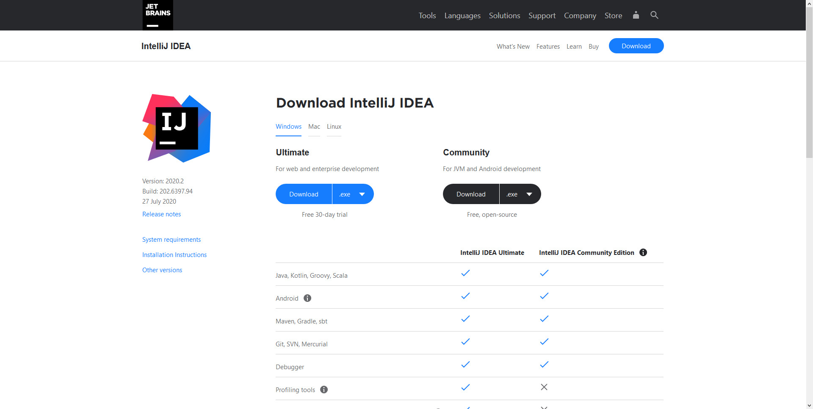
Download IntelliJ

Slide 6
Download IntelliJ

Slide 7
Download Java JDK
Additionally, users will need to download the Java JDK which contains the Java Compiler (among other things).
The Java JDK can be obtained via oracle.com:
Download Java JDK

Slide 8
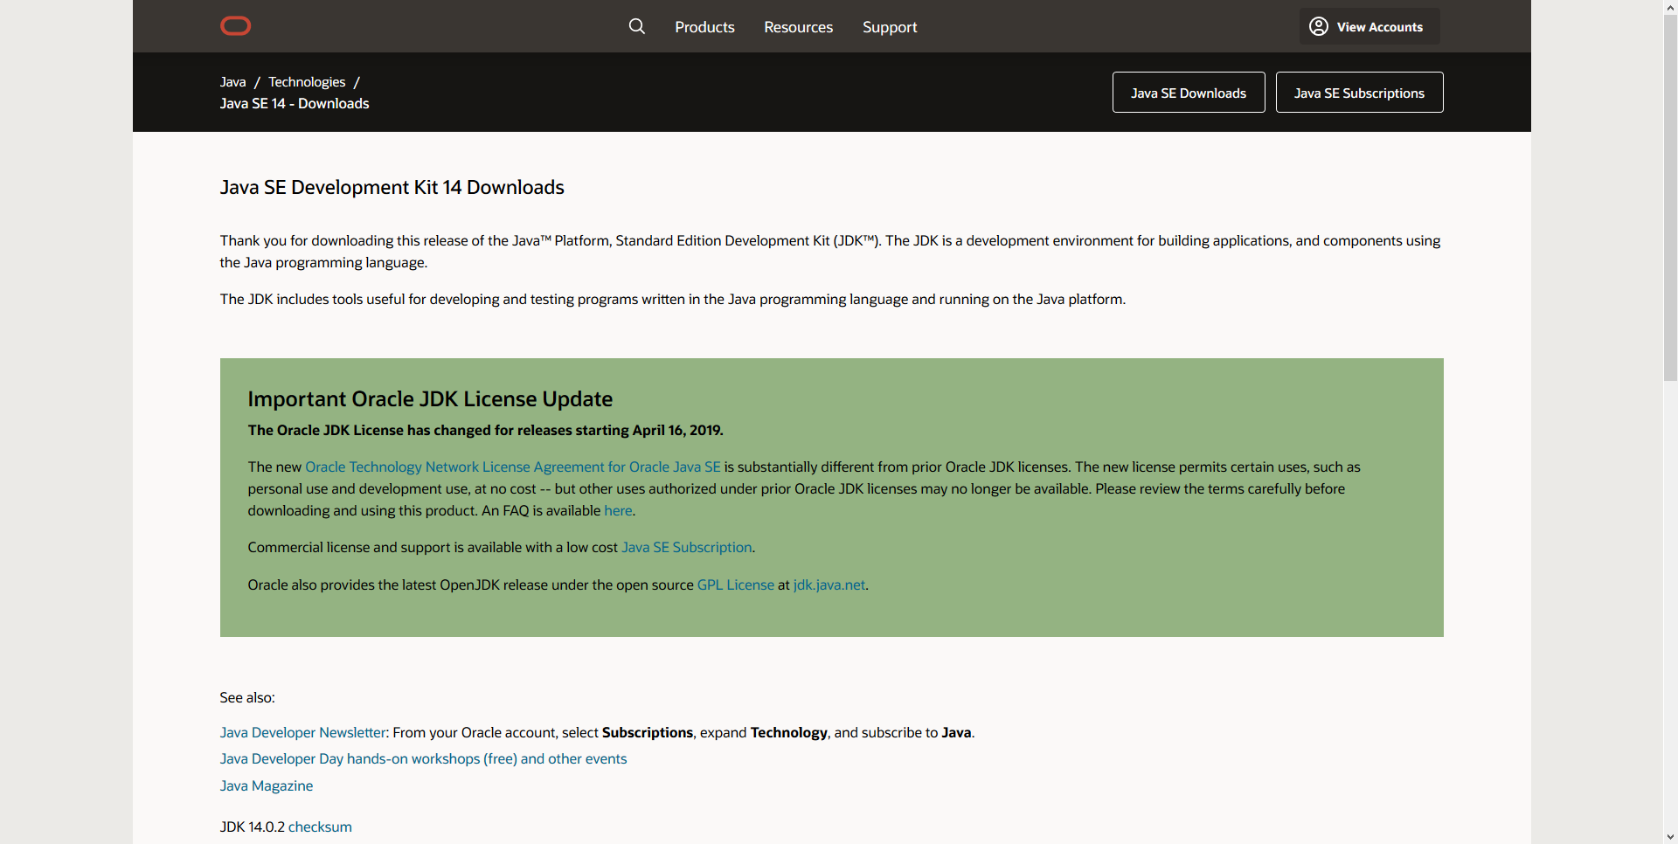
Download Java JDK

Slide 9
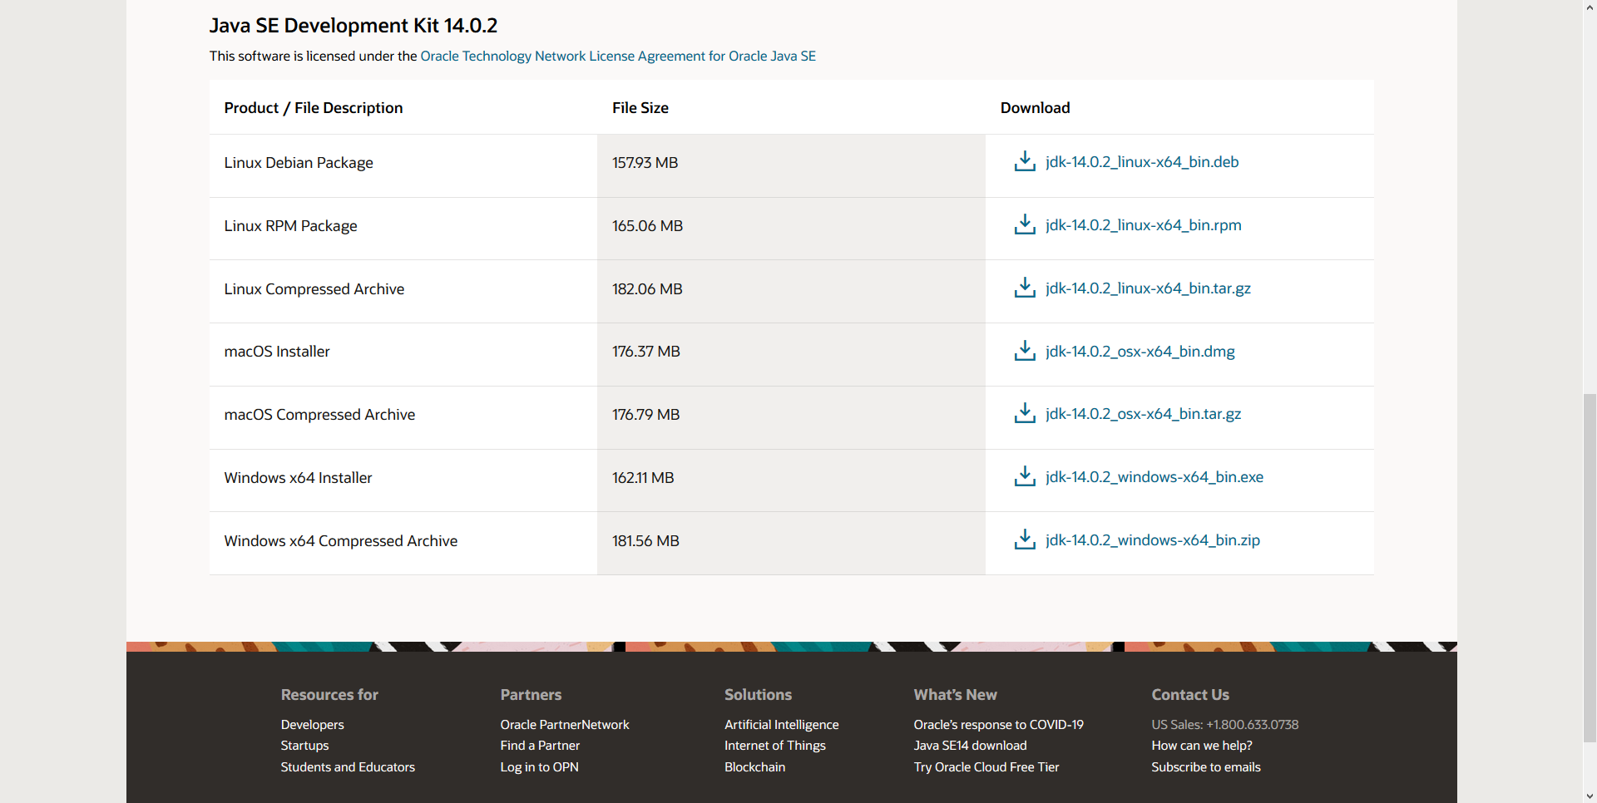
Download Java JDK

Slide 10
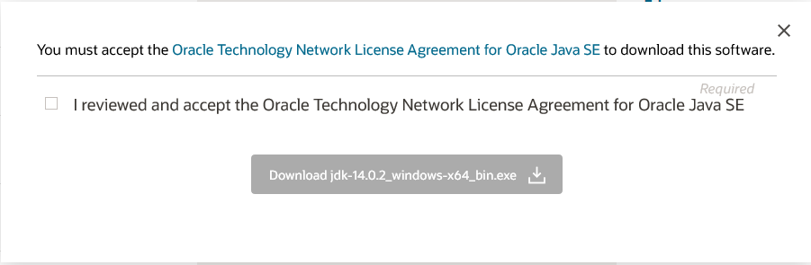
Download Java JDK

Slide 11
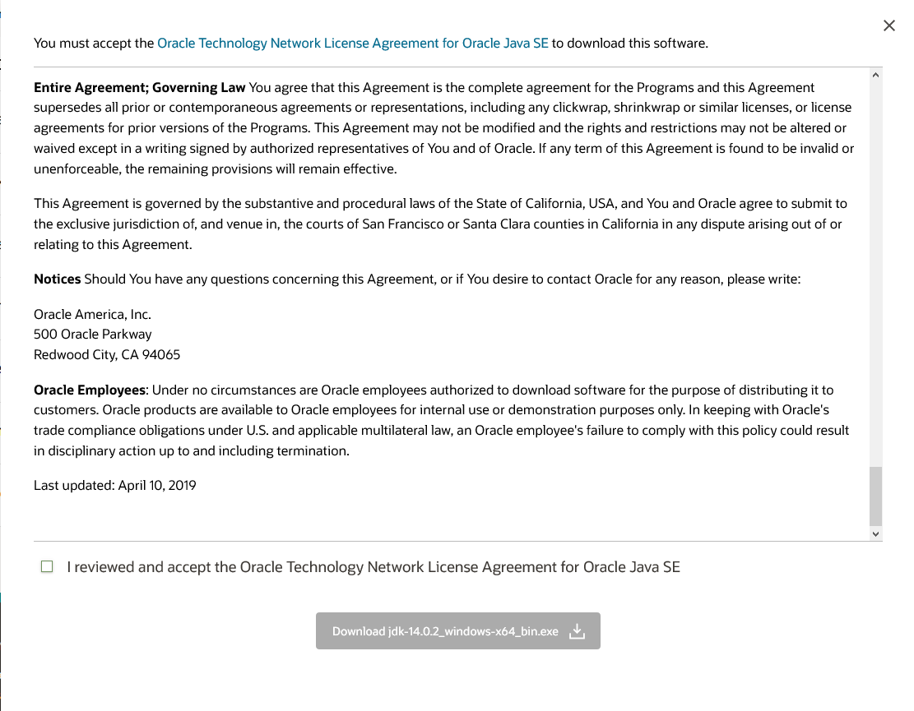
Download Java JDK

Slide 12
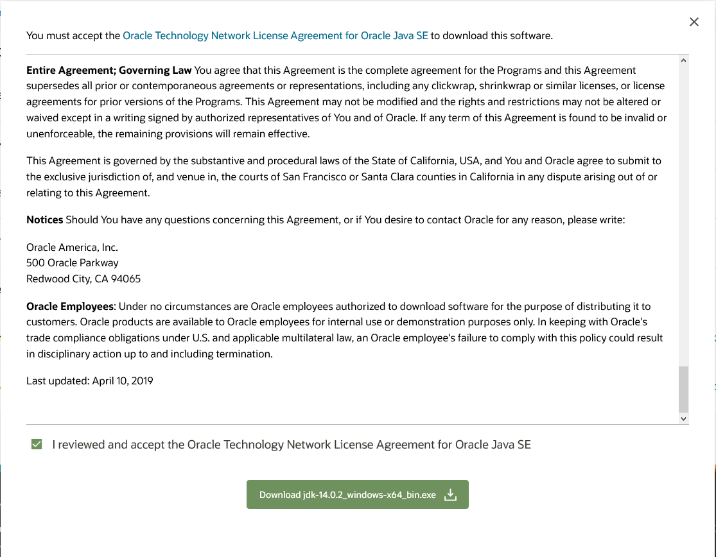
Download Java JDK

Slide 13
Installing
Both pieces of software come with simple install wizards that walk you through the installation process. You shouldn’t have to make any adjustments.

Slide 14
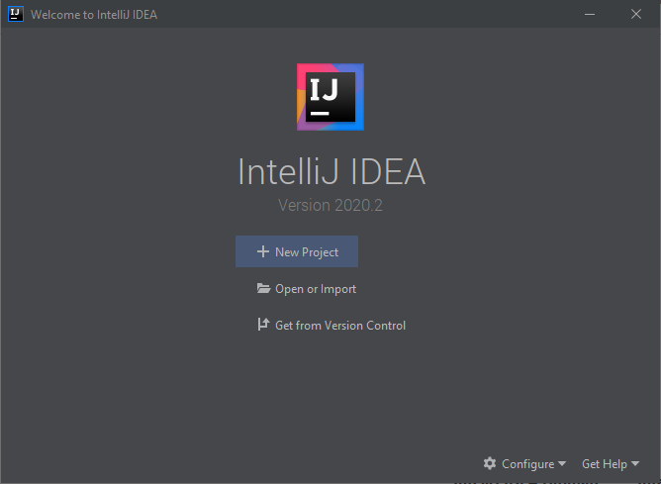
Click “New Project” to create a new project.

Slide 15
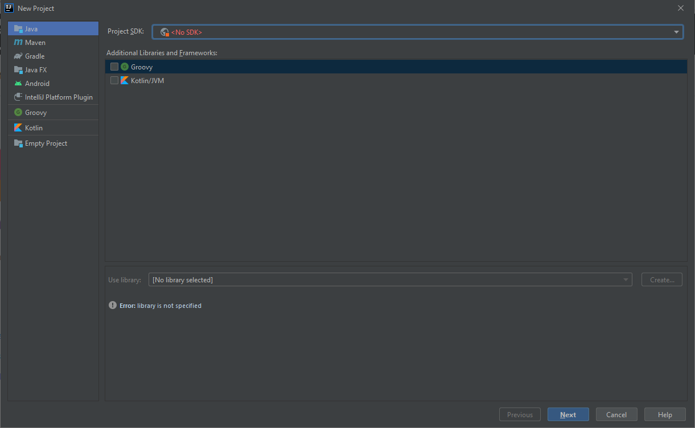
Direct the new project to the Java Development Kit (JDK)

Slide 16
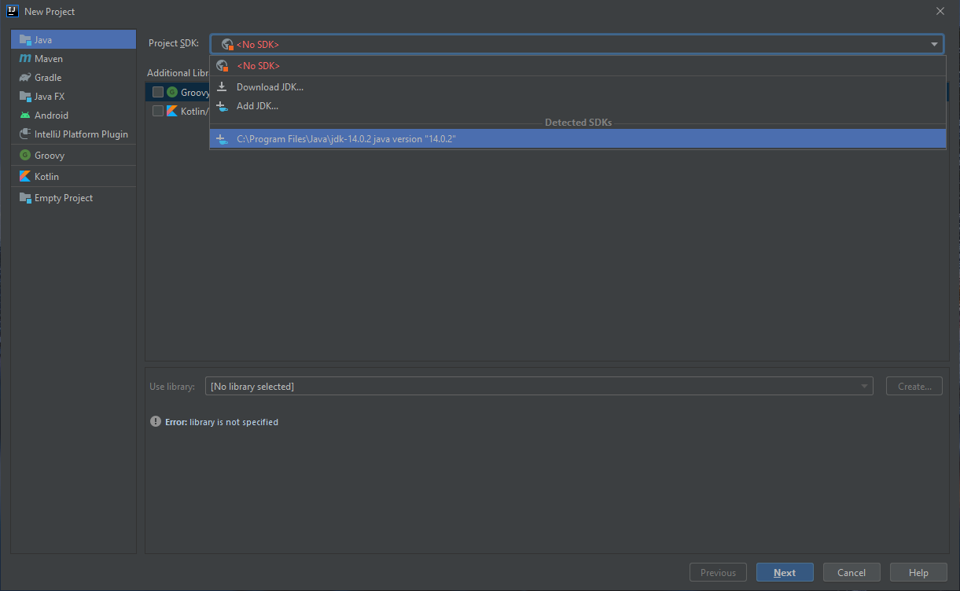
Direct the new project to the Java Development Kit (JDK)

Slide 17
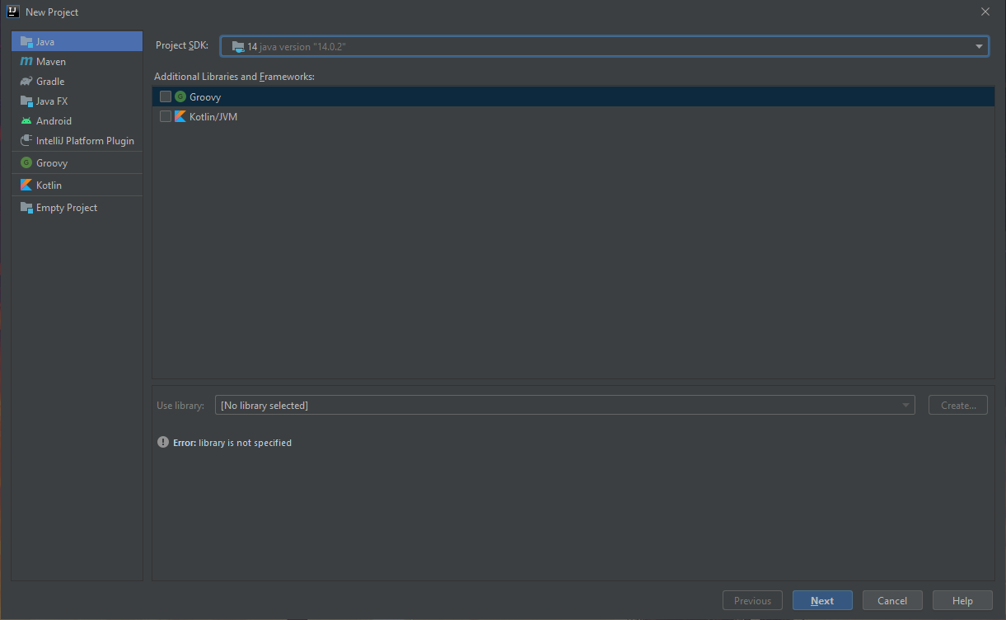
Click Next.

Slide 18
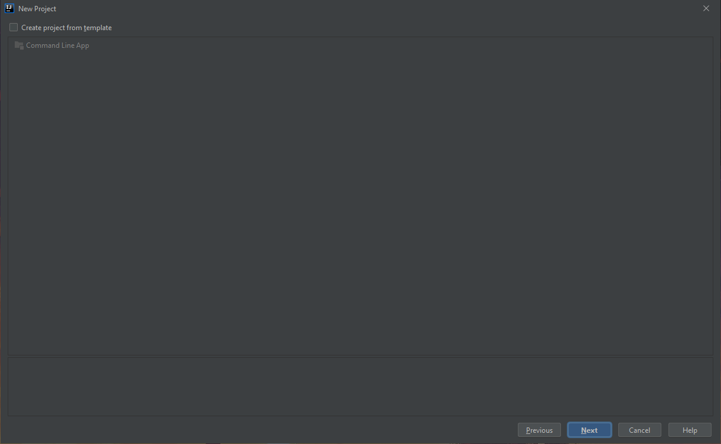
Click Next.

Slide 19
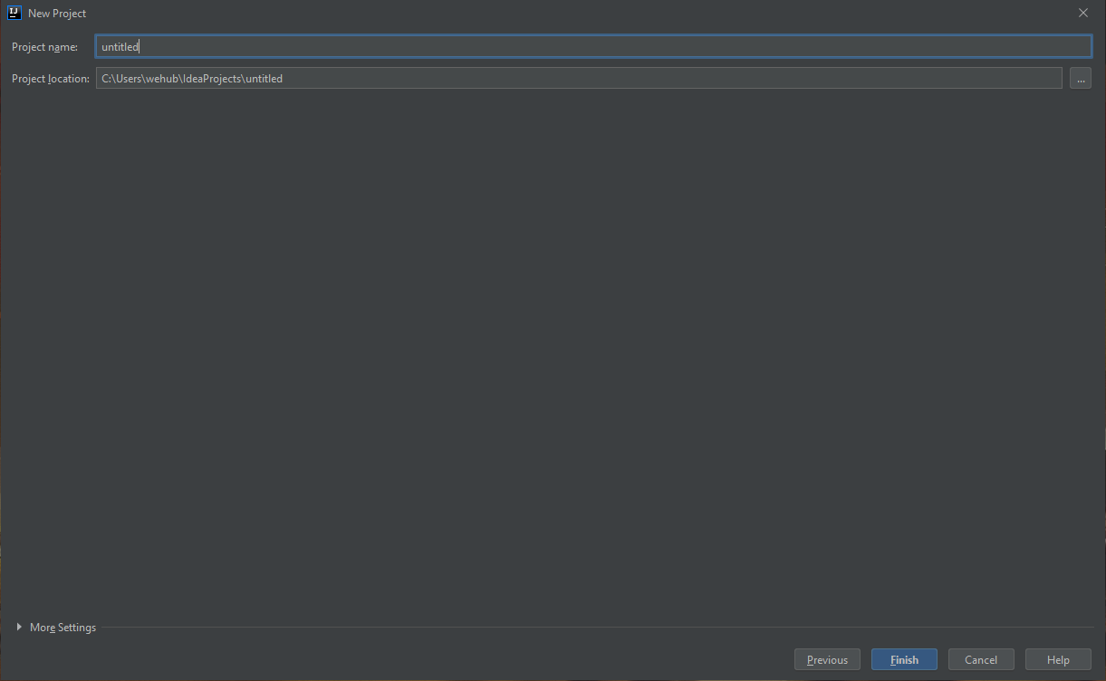
Name your project.

Slide 20
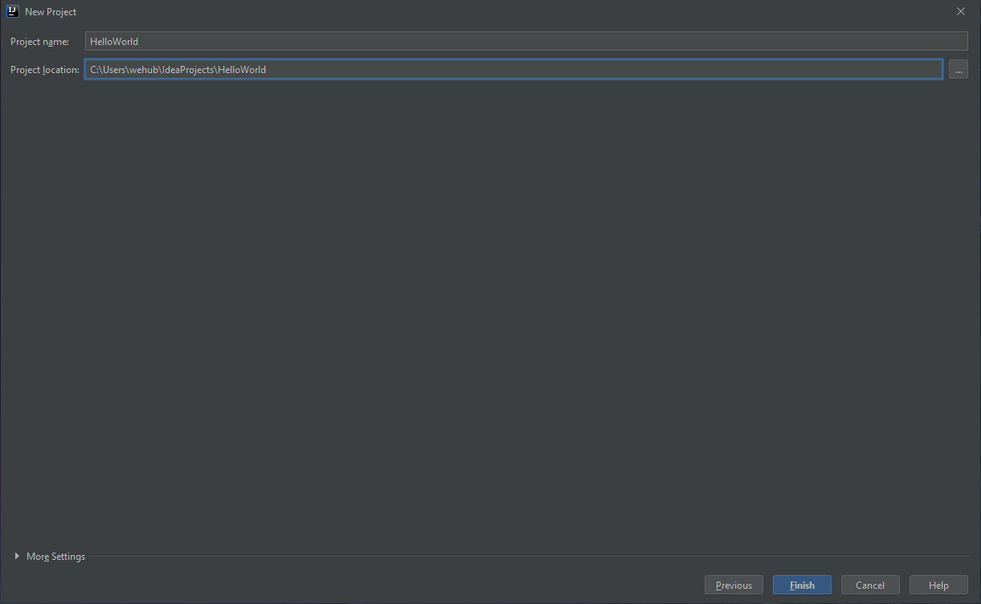
Click “...” if you want to change where your project is saved.

Slide 21
Click Finish.

Slide 22
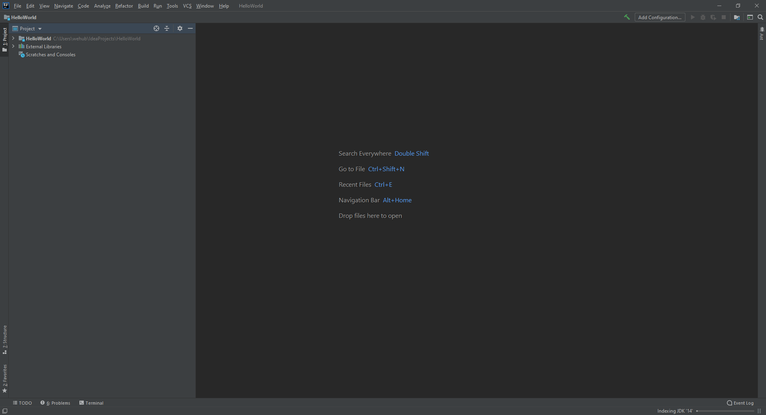
This pane is known as the “Project” or “Package” explorer.

Slide 23
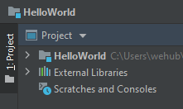
Click the arrow beside the project folder to expand the folder.

Slide 24
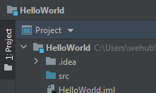
Click the arrow beside the project folder to expand the folder.

Slide 25
All source code (.java files) should go in the src folder.

Slide 26
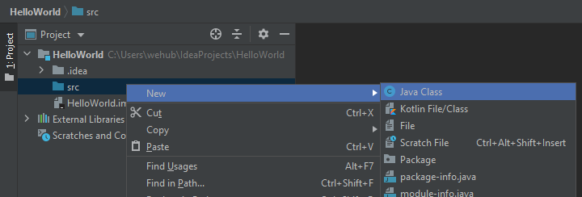
To create a new class (.java file), right click on src and choose New → Java Class

Slide 27
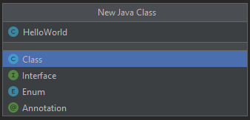
Name your class. The name does not have to match the name of the project.

Slide 28
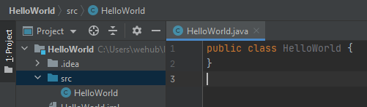
The file HelloWorld.java has been created inside the src folder.

Slide 29
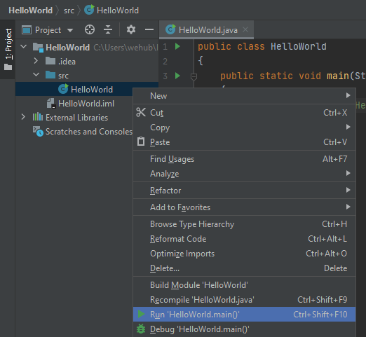
In order to compile and run the code for the first time, right click on the .java file in the project explorer and choose “Run”.

Slide 30
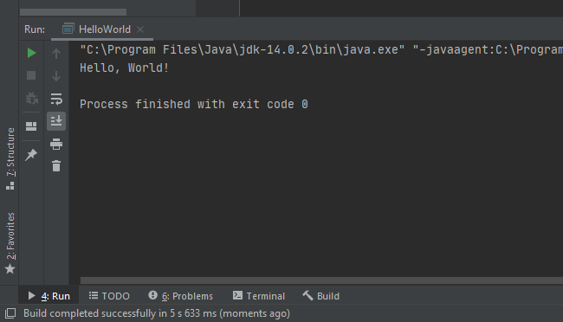
The console will appear at the bottom if the source code prints to the console.

